Slide 1
Best Dubai tourist attractions

Slide 2
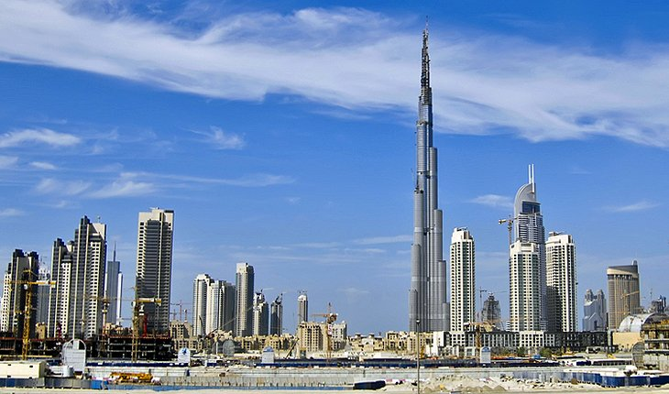
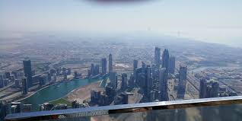
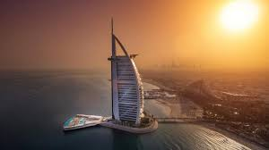
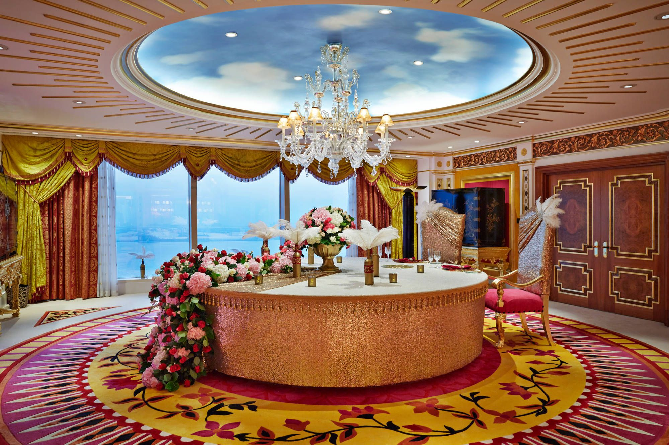
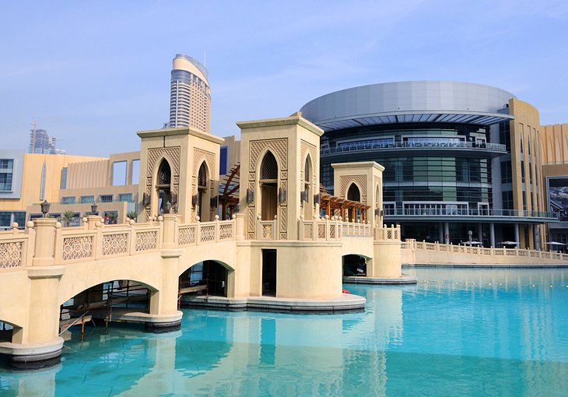
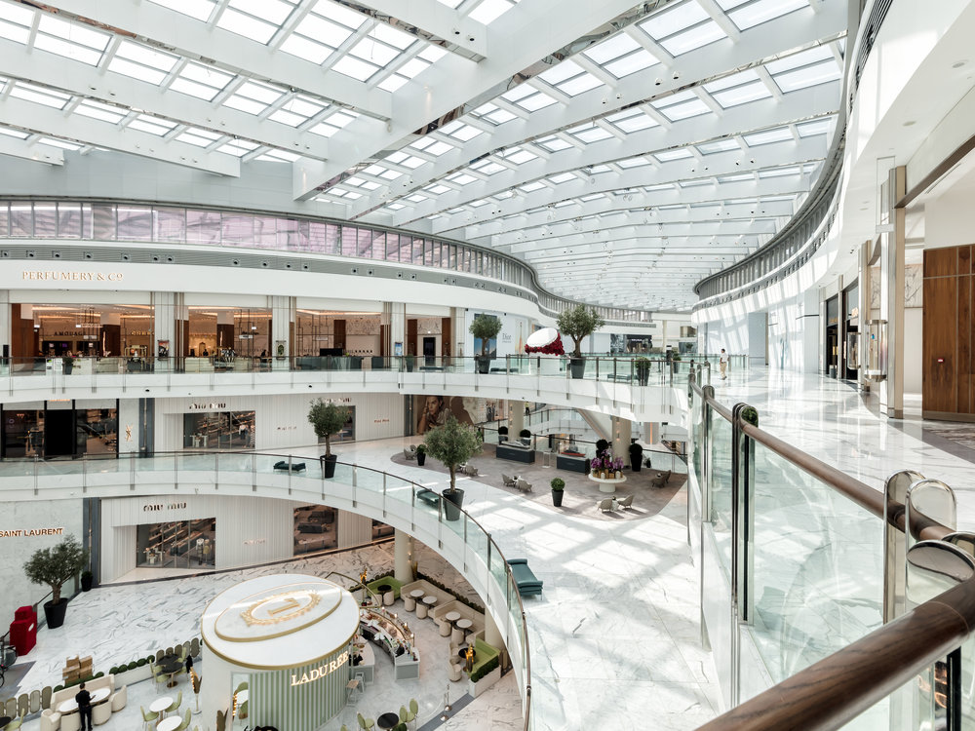
Burj Khalifa:
Burj Khalifa is the tallest building in the world with a height of 828m. It provides a beautiful view of the city as well as an adrenaline when you are on the edge of the balcony. Visiting this tower is a must for any tourists in the city. Nighttime visits are amazing because you get to see the city light up from the 828m above the ground! You don’t even need to get in the building, the ground is good enough. There are many gardens, fountains around the building.
Burj Al Arab:
Burj Al Arab one of the worlds tallest hotels, it is located on its own artificial island. It is built to look like a sail and the building is lit up at night. This is the most expensive hotel however this pays off due to the fact that the hotel is 7 star., the interior is very luxurious, and it comes with a beautiful sea view. You are also able to have dinner in the underwater restaurants and there is the Skyview bar were you can have tea and other drinks! Along with this, people who have rooms in this hotel have easy access to Wild Wadi ( a brilliant water park)
Dubai Mall:
Dubai Mall is the city’s premier mall the provides direct entry to Burj Khalifa as well the Dubai Aquarium. There is also an ice-skating rink, gaming zone, and cinema complex if you're looking for more entertainment options. The shopping and eating is endless, and there are nearly always special events such as live music and fashion shows within the mall. The most famous of these are the annual Dubai Shopping festival and Dubai Summer Surprises festival.

Slide 3
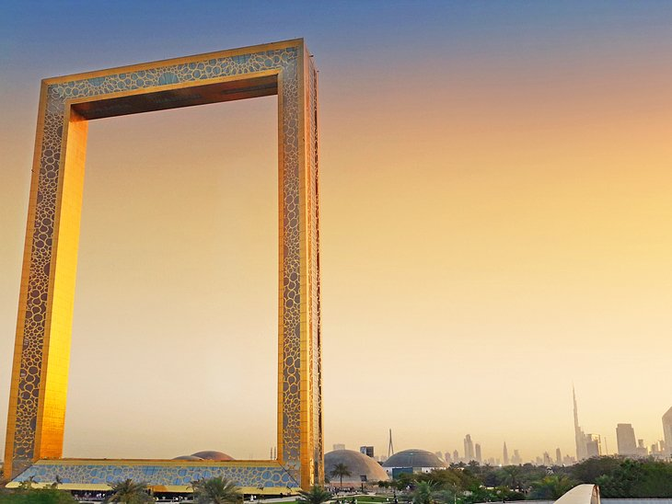
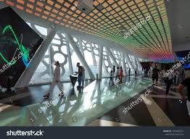
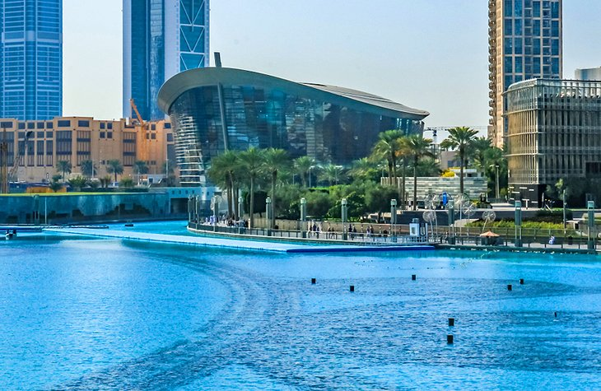
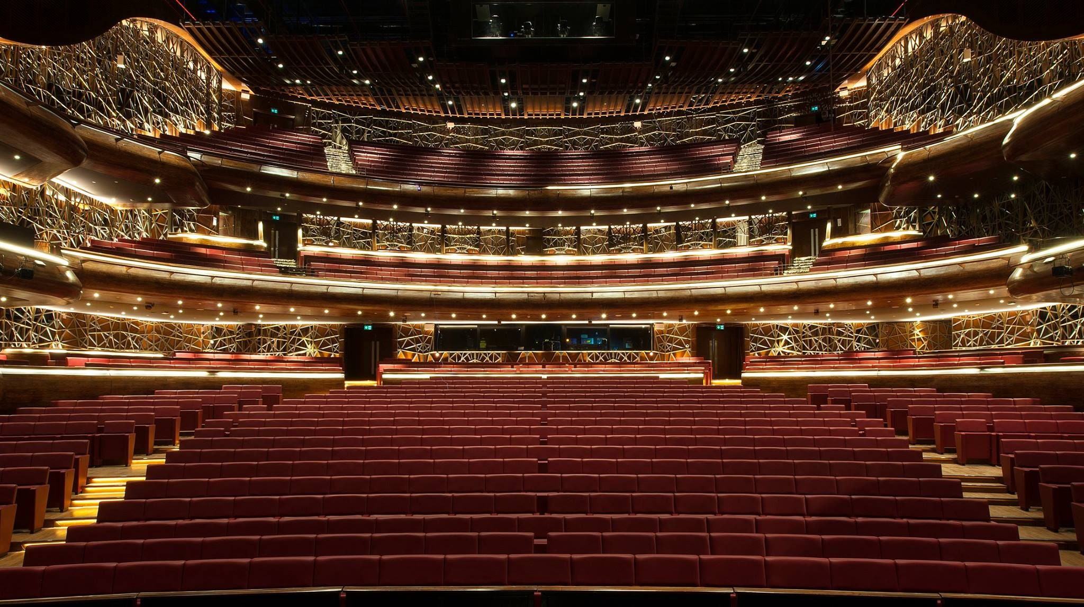
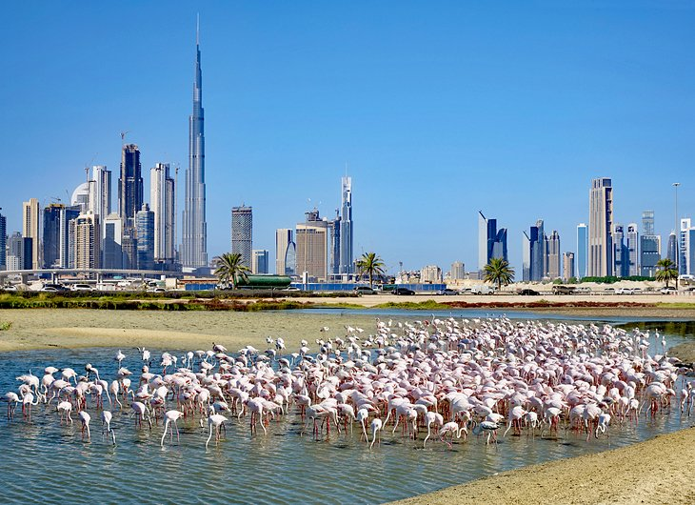
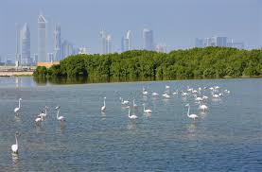
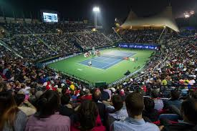
Dubai Frame:
The Dubai Frame sits in between old and new Dubai. clustered around the creek and the city's modern sprawl, this ginormous 150-meter-high picture frame is one of Dubai's latest sights. Inside, a series of galleries whisk you through the city's history and explore Emirati heritage before you travel up to the Sky Deck, where there are fantastic panoramas of both old and new Dubai to be snapped on the viewing platforms.
Dubai Opera:
For nighttime attractions, look no further. This opened in 2016. It’s Dubai's classy new opera building is the centerpiece of the waterfront Opera District in downtown Dubai and set to become the city's major cultural hub and main entertainment venue. The Dubai Opera hosts a year-round program of famous musical theater productions, concerts by world-class musicians, opera, ballet, and classical music, as well as smaller productions, comedy nights, and concerts. This huge building contains 2000 seats for all audiences to sit in.
Ras Al Khor Wildlife Sanctuary:
You don't have to go too far away from the skyscrapers to soak up a more natural view. The Ras Al Khor Wildlife Sanctuary incorporates the mangrove forests and wetlands of Dubai creek. An important stop-off on the migration routes, it's a prime place to spot flamingos in winter when massive flocks of these majestic pink birds rest through the lagoons. Various hides in prime spots have been set up within the park to allow bird-watchers good views of the bird life.
And, if you are lucky enough to come in February, you can witness the Dubai Duty Free Tennis Championships where many famous stars will be playing

Slide 4

Please don’t come in this period. Stay home.

